Slide 1
Doane, Title III, and our students

Slide 2
What is Title III program?
Federal Department of Education, designated by legislation
Strengthening Institutions Program (SIP)
  Aimed at strengthening institutions that serve significant population of Pell-eligible students
To apply for Title III funding in 2015, at least 46% of our students had to be Pell-eligible

Slide 3
Overall Requirements of Title III Program
The Title III program requires that your grant activities have
two overarching aims regardless of your specific proposal:
  Strengthen the operation of your institution to continue serving Pell-eligible students
  Improve standard retention and graduation rates we are required to report to IPEDS even if not relevant to proposal

Slide 4
Proposal development
Self-study: required component of proposal process to identify strengths and weaknesses
Committee of 5: Kate Marley, Becky Hunke, Heather Lambert, Susan Rocker and Julie Pinnell
Data: local and national surveys, census reports, meetings across university for feedback, ideas and discovery of secret data caches!

Slide 5
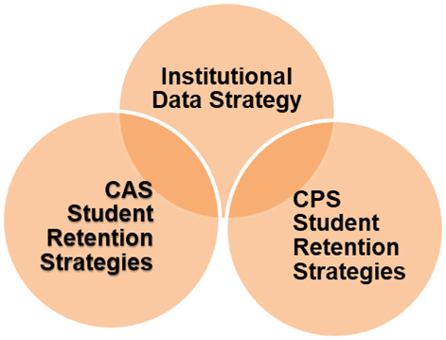
What did we propose?
Institutional:
Supporting data collection, and Improved access to data for data-based decision-making
CAS
Focus 1: Wellness, alcohol norming, education and intervention
Focus 2: Minority student success with peer mentoring, peer tutoring, and faculty development
CPS
Focus 1: Academic Support Center, 2 staff positions
Focus 2: Professional development resources for faculty and staff
Notes:
After extensive literature review we proposed:
CPS:
Development of an Academic Support Center with two staff positions
Professional development resources for faculty and staff
CAS:
Focus 1 on wellness, health, alcohol education, intervention and norming
Focus 2 on minority student success with peer mentoring and peer tutoring at the drop-in Study Helpdesk, faculty and advising professional development
Institution-wide:
Supporting university, departments and individuals to access institutional data more easily and effectively for data-based decision making

Slide 6
How does this work matter?
For the university:
Retaining more students means more revenue
Supporting an inclusive community of learners is our MISSION
For faculty:
Sense of belonging, mentoring, tutoring, support higher acad. achievement
Better work=happier grading!
Sober students learn better!
For students:
Support, community, belonging, academic success
Normalized alcohol use that doesn’t undermine goals
Earn credits and graduate, less debt
Notes:
To the institution:
Data-based decision making will result in all areas of the university able to respond effectively to opportunities and make decisions based on what is really working
Retaining more students will result in increased tuition income
Supporting and retaining an inclusive community of learners is our mission
To students:
With additional support, students are more likely to find a community, a sense of belonging and academic success.
With a recalibrated sense of normal alcohol use, students can choose to socialize in ways that do not interfere with their goals.
Being academically successfully moves students toward completed credits and graduation, while minimizing debt as much as possible
To faculty:
When students are making better choices while socializing they are more likely to do well academically
Community and a sense of belonging are needs that when satisfied make it possible for students to achieve at higher academic levels
More academic support also makes higher academic achievement possible
Students successfully achieving course objectives make faculty happy when they are grading!

Slide 8
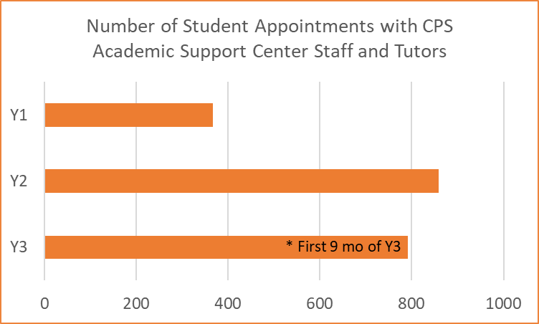
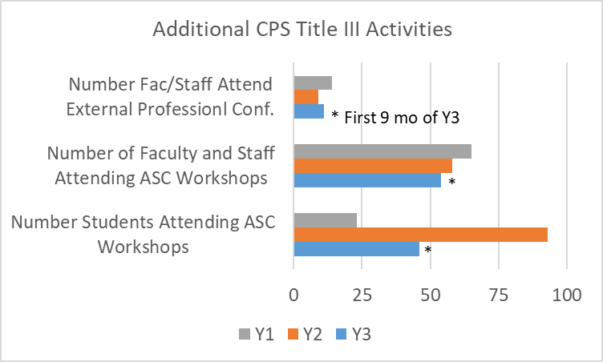
Notes:
Student workshops on Writing, APA format, Time Management
Facutly and staff workshops on a wide range of topics
Professional conferences for faculty and staff are the first resources for travel to conferences and workshops that CPS

Slide 9
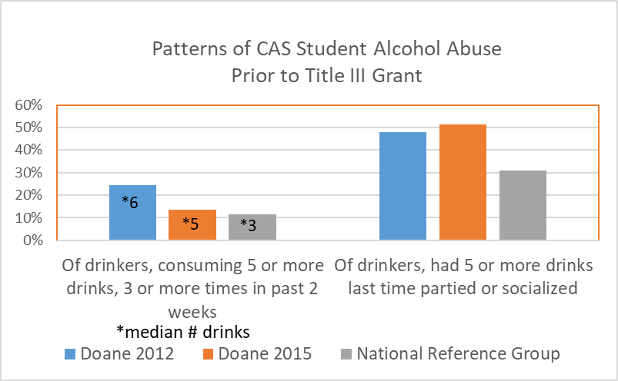
College of Arts and Sciences – self study

Slide 10
Minority student support
Tiger Success Mentoring
Students selected based on accumulation of risk factors – race/ethnicity, out of state, low ACT, HS GPA
Peer support for thriving at a white institution, social navigation
Academic skills, time management
Mentors meet weekly with director on message for week and problem solving concerns for their mentees
Valuable growth for mentors as well

Slide 11
Minority Student Support
Study Helpdesk
Drop in peer tutoring
Learning Commons – Library
Sunday-Thursday 7-10pm
All students welcome
8 highest demand subjects
  Accounting
  Biology
  Chemistry
  Economics
  Mathematics
  Physics
  Psychology
  Sociology
Use higher in fall than spring

Slide 12
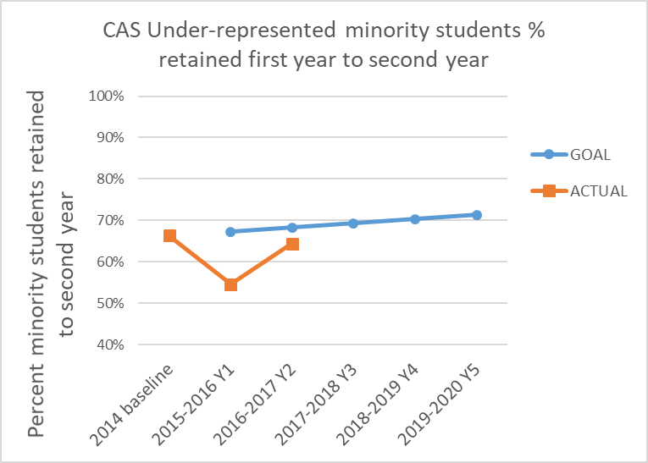
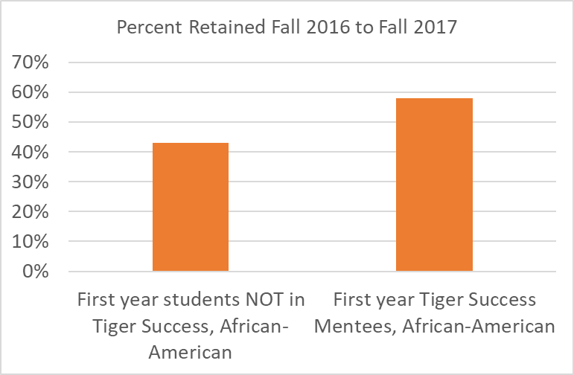
Minority student retention
New this year – Tiger Success Peer Mentoring expanded for all students supported in Academic Success
  And Wilma Jackson has a Student Affairs Grant for First Generation students, connect with Tiger Success

Slide 13
Climate of heavy alcohol use
Between 2012 and 2015 Interterm was ended
So while fewer male students may have consumed 5 or more drinks 3 times or more times in the past 2 weeks, more than 50% of male drinkers were drinking 5 or more drinks when they did drink.
The median of 5 drinks in 2015 hides the fact that Doane male drinkers’ median was 9 drinks.
COMPARED TO THE NATIONAL REFERENCE GROUP, Doane’s drinking levels were way beyond “normal college” heavy alcohol consumption.

Slide 14
Heavy alcohol consumption and college success
Heavy drinking interferes with successful college goal setting and achievement
First year students and male students are the most susceptible to messages that they need to drink to fit in
Students drinking heavily and at high frequency are much more likely to leave college

Slide 15
Alcohol Norming Campaign
Students regularly believe that more of their peers drink much more alcohol than they do
Norming: Ask students on a survey what percentage of their peers drink, and then provide the actual survey results immediately to the students
Real time results indicate the actual percentage who drink and who abstain
Students who know the real drinking norms on their campus are much more likely to chose NOT to drink, OR to drink LESS

Slide 16
Remainder of programming
Wellness – Student Wellness Action Team
Healthy give-aways, games and wellness messages, alcohol education tucked in everywhere
Alcohol education – portion sizes, harm reduction
Alcohol-free weekend social events that are crazy fun
Direct programming for campus organizations, Greeks, Athletics
Brief motivational interviewing and counseling for students dealing with alcohol/substance abuse or violations

Slide 17
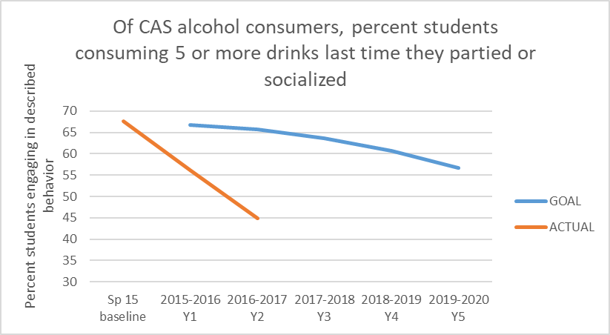
Title III results – normalizing drinking frequency
Choosing healthy is normal
Not drinking is normal
Drinking responsibly is normal
Getting black-out drunk is NOT normal

Slide 18
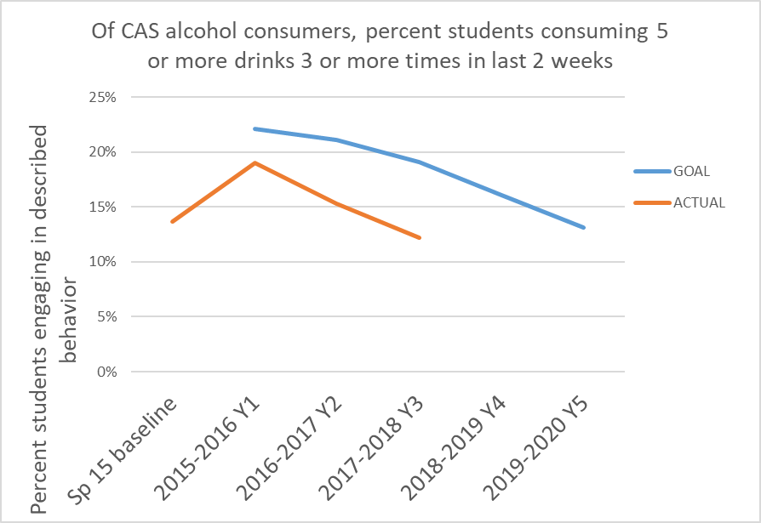
Title III results – normalizing drinking quantity

Slide 19
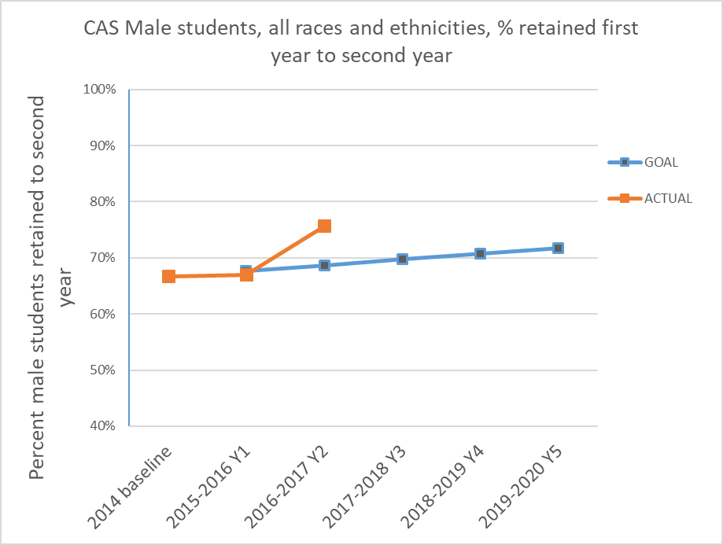
Climate of normalized alcohol use - improved retention of male students

Slide 20
Other evidence of changes in Climate for Alcohol Consumption
Changes in student behaviors – fewer BASICS appts
Students electively requesting BASICS appts
Popularity of SWAT program, Wellness Wednesdays

Slide 21
Institution-wide Data Strategy
Director of Institutional Effectiveness
Initial focus on helping grant staff collect appropriate data in effective ways
Also helped develop QI project for HLC
Currently supporting IT improvements to IDEA implementation
Eventually will be able to provide more support for a variety of assessment work across the university, has expertise and passion in qualitative methods, also strong in quantitative methods

Slide 22
Why does this work matter?
Students cannot be successful academically unless they:
  Feel like they belong on campus and in their classes regardless of skin color
  Keep their drinking at a level that does not interfere with their goals
  Limit their heavy drinking frequency so they can get their homework done
  Recognize and match “normal” drinking
  Are respected by faculty and peers
  Have access to support services that they need to succeed academically

Slide 23
Part 2 – The role of faculty and advisors
What faculty can do to support minority students and male students?

