Slide 1
Workforce Ready (New Kronos)
Log-in Instructions

Slide 2
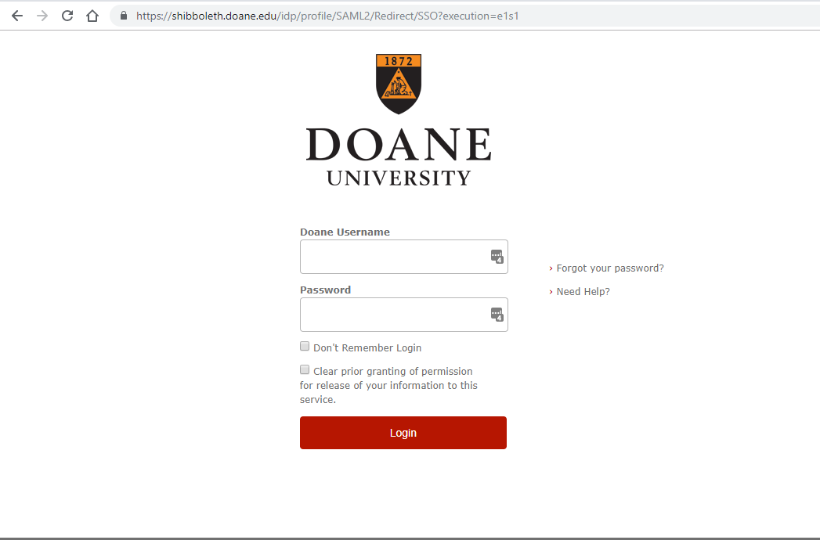
Workforce Ready - web link
Pick your favorite browser! Go to www.doane.edu/kronos
Use your regular Doane user name & password to log in.

Slide 3
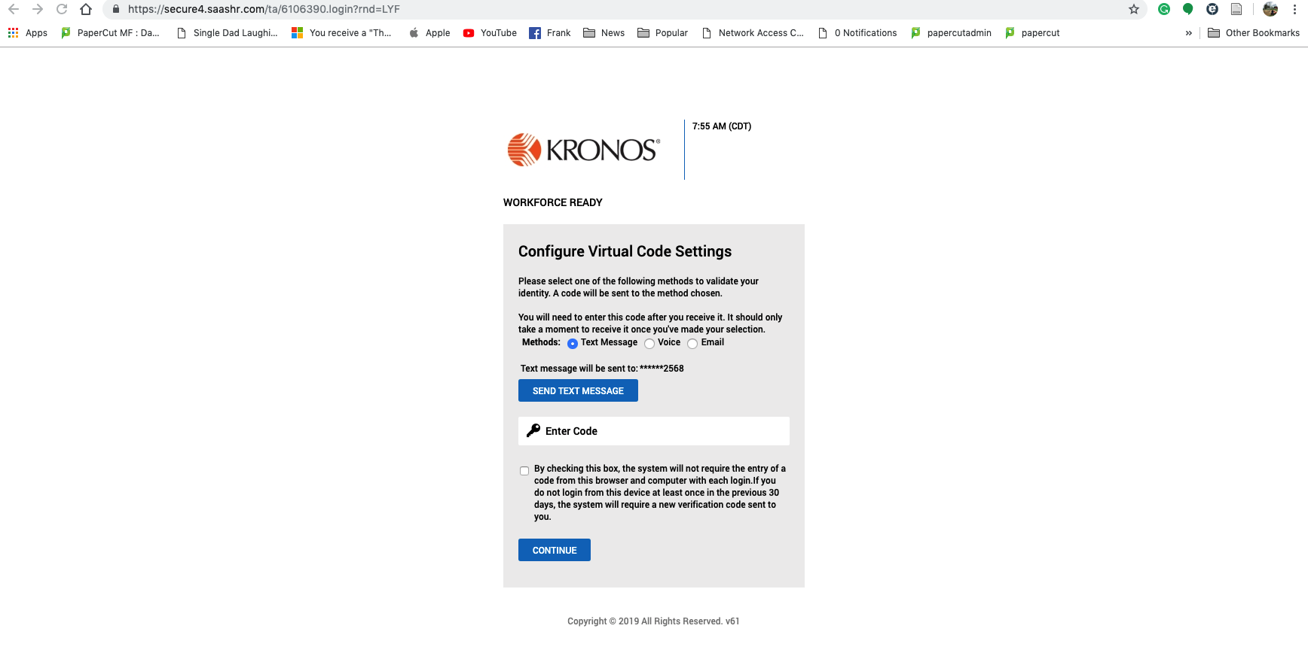
On first log in, you might see this screen:

Slide 4
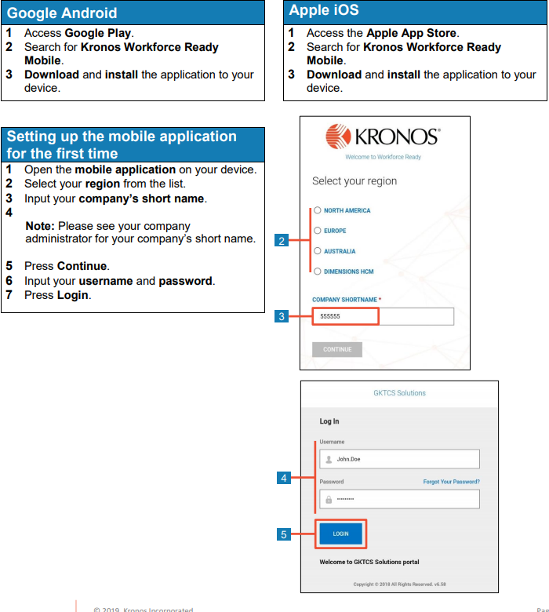
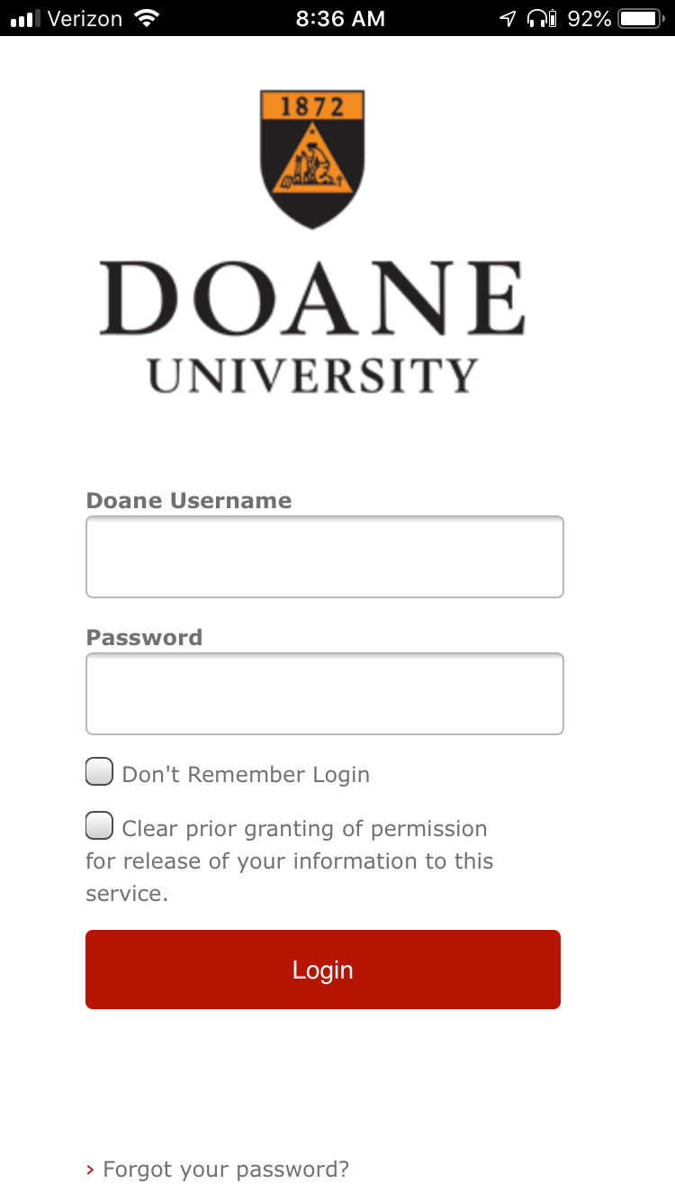
Mobile App:
Follow the steps here
For Step 3, the “Company Short Name” you’ll need is:
6106390
Once you press “continue” you will see the “Doane University” Authentication page.
You must click “Allow” location services in order to use the mobile app.

Slide 5
Resources for Further Assistance
Training Materials:
https://www.doane.edu/its/how-to-videos
Self Service:
Work Force Ready “My Learning” page
Tiger Tech - Ext. 68411 or helpdesk@doane.edu
For HR related questions – humanresources@doane.edu

